Slide 1
Data Modeling Concepts Part 2
<Data Model 101 Series>
Anand Kumar
Notes:
Hi. Today I am back with the part 2 of the Data modeling series.
The module would cover the basics of Data Modeling Concepts.
Let us begin our session.
© 2009 Wipro Ltd – Internal & Restricted
‹#›

Slide 2
Data Modeling Overview
A method by which the enterprise business model is defined in terms of data elements and the relationships existing among those data elements.
Provides data view of the business model in a graphical representation of data elements as entity sets and business rules as relationships lines connecting the entity sets.
The data modeling details are covered in three parts,
Part 1 – Introduction to Database System and Context of Data Modeling.
Part 2 & 3 - Data Modeling terms and concepts and Data Modeling in Data Warehouse environment.
Notes:
Data Modeling is a process by which the enterprise business model is defined in terms of data elements and the relationships existing among those data elements.
The enterprise business models are like order processing system, dispatch system, employee management system etc. These are based on the various processes that can exist inside the enterprise. Each process is defined in terms of data elements and the business rules. Data modeling is the logical structuring of these elements and rules.
There are many benefits of Data modeling such as:
-Easy access to information and easy modification of information.
-Less storage space as data redundancy is reduced and so less cost of data maintenance.
-Easy to incorporate new changes and scalable. A business model goes through changes overtime, the data model provides the flexibility to adopt these changes.
These details are covered in three parts. Just to jog your memory, In part 1, we covered Introduction to Database System and Context of Data Modeling. This presentation is part 2 of the series.

Slide 3
Data Modeling Objectives
Upon completion of this module you will be able to:
Understand how the data model is derived from Conceptual Model
The importance of Data Model
Familiarization with terms and concepts of Data Modeling
Notes:
Data modeling is done to integrate and manage the data of a business. It is done based upon certain standards. For e.g. when it follows relational data modeling the data structures are treated as entity sets and set of relations and follow mathematical set theory.
The inputs to data model are the business processes and business rules.
Upon completion of this module, you will be able to
-Understand how the data model is derived from Conceptual Model
-The importance of Data Model
-Familiarization with terms and concepts of Data Modeling

Slide 4
Data Modeling Outline
Lesson 1 Data Modeling Overview
Lesson 2 Data Modeling – Terms and Concepts
Notes:
This module has 2 Lessons.
Data Modeling Overview and Data Modeling- Terms and Concepts.
© 2009 Wipro Ltd – Internal & Restricted
‹#›

Slide 5
Data Modeling Overview
User views, Type of data models
Notes:
Let us start with an outline of data modeling.
The data modeling is carried out in phases, namely-conceptual, logical and physical. This phased or layered approach has immense benefits.
As the three layers are relatively independent of each other, multiple database vendors find it highly portable . The logical model can be implemented on various databases for e.g. Oracle, Sybase, DB2 etc, where it is converted to physical model. The architecture of different databases can be different but the data model is same. The data model is not bound to any database vendors. The company thus gains benefit from this, and can choose from multiple databases based upon cost, ease of use, maintenance benefits. For e.g. In the same company one business process can run on Oracle, while other on Sybase.
We will cover each layer in more details including Data Model Benefits and Use of Data Model.
© 2009 Wipro Ltd – Internal & Restricted
‹#›

Slide 6
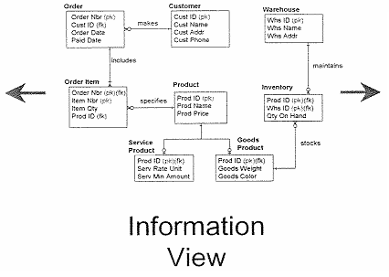


User Views
The business view represents many different perspectives of the same data.
The technical view represents the physical view of the data where there may be many databases and files for the same data.
Therefore the information view/user view (i.e. data model) consolidates both the business view and technical view into one representation.
Notes:
A data model is an Information view/User view which consolidates business data to form a repository.
The business view represents many different perspectives of the same data. For example: suppose an organization has business location in home country and in foreign countries. The customer of a particular foreign country is local to the sales department of the organization located in same foreign country. But for the sales dept in home country, the customer is not local.
The technical view represents the physical view of the data. It shows how the data model is implemented in a particular database for e.g. Oracle, Sybase etc. So there can be multiple physical implementation of business view.
The information view consolidates both the business view and technical view into one representation.
The consolidation of technical view and business view, gives easy representation of business process for the combined business and technical people. It integrates right from the business process till data storage and its retrieval.
© 2009 Wipro Ltd – Internal & Restricted
‹#›

Slide 7
Types of Data Models
Conceptual
Business Users
Logical
Designers
Physical
Implementers
Multiple levels of abstraction, ranging from very general to highly specific.
Notes:
There are three types of data models.
What we have on top, is the conceptual model. The conceptual model mostly suits business people. It is developed in consultation with business people. The level of abstraction is very generic here.
The one we see below is the logical model. This is derived from the conceptual model. It suits designers. It contains entity and attributes details.
Finally, the physical model. This is derived from the Logical model. This mostly suits the Implementers. It is database specific.
The level of abstraction is highly specific. The data type, relation constraints, attribute data range all are defined here.
In database projects it is desirable to have the conceptual model. The logical and physical model are must to have.

Slide 8
Conceptual Data Model
A Conceptual data model is :
Semantic layer representing business view
Database and technology, organization independent
High level model depicting core subject areas and key entities
in each subject area
Notes:
In Conceptual data model the high level picture of business is defined.
The entity classes defined here shows the significant things of the business. It is also a language to translate business process to data elements.
For e.g. it shows that a customer can have multiple addresses. The address is a multi valued attribute. How the address will be defined and stored in the system is placed in further layers.
It also defines the scope of the process. For e.g. a business may have order process, dispatch process, billing process etc. If the model is showing order details the scope is defined to this process. It helps in modularization of the processes.

Slide 9
Logical Data Model
A logical data model (LDM) is:
Conceptual
Database, technology and organization independent
A non-redundant single representation for all user views
A picture that captures and communicates the information and business rules of the organization
Notes:
A logical data model (LDM) is created to capture and communicate the business rules of an organization.
It is derived from conceptual model.
It is database, technology and organization independent. The logical model can be implemented on multiple databases like oracle, Sybase etc. The business can choose from the databases as per it needs.
It shows the business requirements in a pictorial (better known as graphical) format.
During its development, technology and organization impacts are not considered. Approximately 95% of the modeling effort should be invested in the development of the logical data model. It needs more time since a change here has multiples impacts on user interfaces.

Slide 10
Defining Business Rule
The structure and relationships (formal or informal) of the policies, business practices and guidelines which govern the way an enterprise conducts business.
Business analysis and application development require a clear, consistent and unambiguous understanding of the underlying business rules of the enterprises.
Example:
A premium payment is applied to one policy
A policy is issued by one insurance company
Notes:
In the development of the logical data model the business rules are captured.
The business rules are - structure and relationship of the policies, business practices and guidelines which govern the way an enterprise conducts its business.
Examples are:
A premium payment is applied to one policy.
A policy is issued by one insurance company.
A customer can place one or more orders.
The business rules are provided by business people of the company. For a localized company which has business in one country The business rules are simpler than a company which has presence in multiple countries. For e.g. the localized company has to deal with one currency of representation while other has to deal with multiple currencies. Business rules are also affected by government rules and regulations. The business rules are also subject to change. For e.g. the tax rules on salary can change each year as the government policies change.
The data model should be flexible to accommodate the changes.

Slide 11
Physical Data Model
A Physical Data Model (PDM) is:
Physically implemented as a database
Targeted for a specific database platform such as oracle, Sybase, ingress, Informix, DB2 etc
An implementation of some or all of the business rules specified in the LDM
Geared for performance and may consist of redundant data
The main focus of development should be the logical data model.
Notes:
A physical data model is - a physically implemented database.
Here the attribute type, its data range, data constraints are clearly defined.
It is targeted at a specific database platform, such as oracle, Sybase, Informix etc.
It contains an implementation of some or all of the business rules specified in the LDM. The business may not want some of the business rules defined in LDM to become operational, so they are not included in physical model.
The physical model is tuned for performance. It will quicken the data storage and retrieval process, For e.g. the use of indexes based on the where clause of the query, the use of partitions for large data.
The logical data model is continually refined and detailed as it evolves into a working physical database.
Depending on the complexity of the LDM, the logical to Physical transformation generally takes 5% of the total modeling effort.
This is carried out in Data modeling tool like Erwin.

Slide 12
Data Model Benefits
A Promotes project success
Quality business requirements definition
Simplifies complex systems
Facilitates effective communication
Simplifies complex systems
Facilitates effective change management
Provides stability to applications
A Model that captures and communicates business rules can be used for virtually any business need.
The act of modeling provides a focused way for business and information technology stakeholders to analyze and define critical business impacts of any project.
Notes:
Data model is the core part of the project. A robust and well designed data model provides multiple benefits to the business.
It promotes project success. A good data model has a bigger stake in project. If the data model is good then chances of project success improve considerably. It provides Quality business requirement definitions.
It simplifies the complex business scenario. As a whole the example in the module order management system looks complex but when it is logically broken down in terms of entity sets, it becomes simpler. It provides modularization of business process, for e.g. the order process, the dispatch process etc. The various processes can be developed independently and parallel to each other.
It facilitates effective communication between the project and business people, since it presents both the business process view and technical view.
It facilitates effective change management. A flexible data model can incorporate changes in business process seamlessly. For e.g. The surcharge on tax keep changing every year. It can be implemented in application or in data mode for calculation. If it is in application then each year its value will change and the application will keep only the current year detail.
If it is in data model with a table with columns like year and surcharge percentage, one can view each year surcharge. Further, multiple applications can use it. If it changes it will change in one place rather in multiple applications.

Slide 13
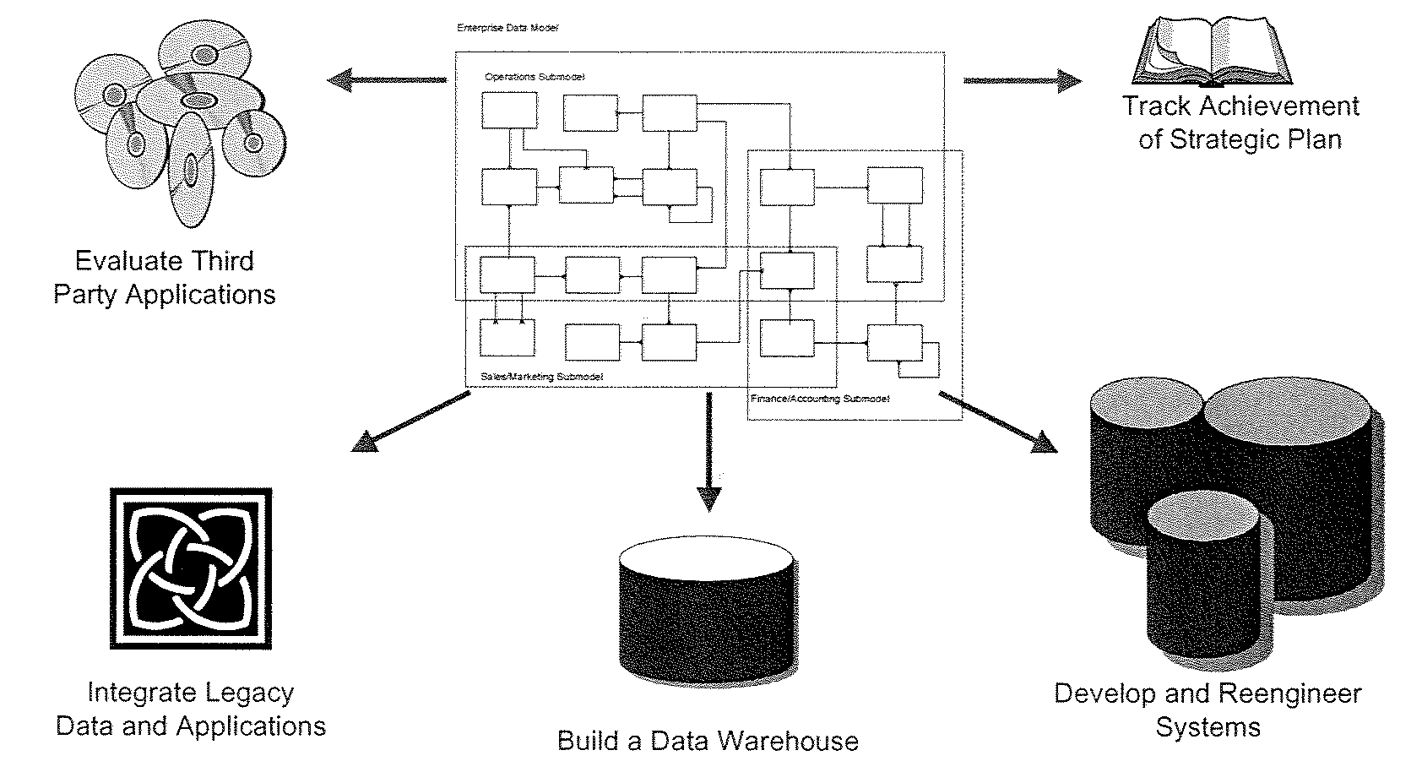
Uses of Data Model
Data model can be used to achieve many different goals.
The classical use of a data model is to develop a database with a systems development or reengineering project.
It is also an integral part of data warehouse development.
Notes:
Data model can be used to achieve many different goals.
Basically it provides business rules for application development people, who need to develop the user interfaces, through which users will interact with the data.
It is used for data intensive projects like order process, dispatch process, payroll process.
It is used for reengineering project.
It is also an integral part of data warehouse development, where it helps in finding correct data pattern in voluminous data and reduces development time for Business Intelligence report development.
Data modeling can also be used to help evaluate third-party applications, integrate legacy data and applications and implement and track achievement of strategic plans.

Slide 14
Data Modeling – Terms & Concepts
Entity type, Business Metadata, primary Key
Notes:
Now we are in the second part of the module. - Data Modeling –Terms & Concepts
As you go through the development of the data model you will encounter the jargon used in it.
We have encountered Entity Types, relations, keys etc before this. Let us understand what each means and what are the concepts behind it.
Some more concepts are covered in Part 3 of this series.
© 2009 Wipro Ltd – Internal & Restricted
‹#›

Slide 15
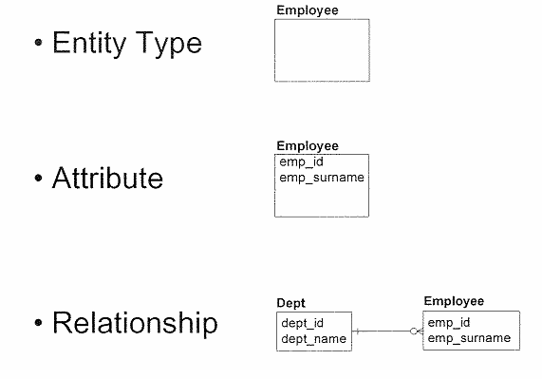
Basic Constructs
A data model is composed of three basic constructs: entity types, attributes and relationships.
Notes:
A data model is composed of three basic constructs: entity types, attributes and relationships.
Basically a business process is defined in terms of entities, attributes and relationships in data model.
First the Entity types and its attributes are determined. Some attributes become part of primary key.
Then relationships are established among entity sets. In some cases like many to many relationship it is further broken down into two one to many relations with creation of one more entity set. The new entity set is known as weak entity set as it has no existence of itself. The entity sets from which it is derived are known as strong entity sets as they have there own independent existence. Some attributes define the property of relationship in better way, so they are passed to the new entity set. More on this will be covered in Advanced data modeling.
In this slide an entity type ‘Employee’ is considered which has attributes as emp_id and emp_surname.
Also a relationship between Dept and Employee is shown.

Slide 16
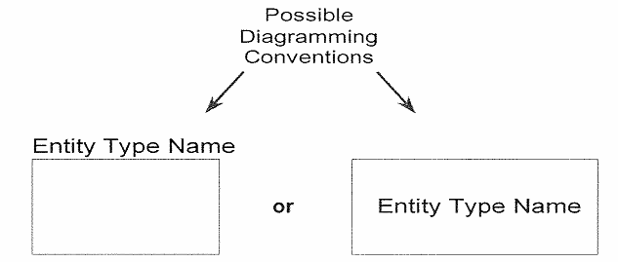
Entity Type
An entity type is a type of person, place, thing, concept or event which an organization must manage and for which data is stored.
Common examples of entity types include those of customer, employee, location, order, vendor, part etc.
Other common examples of entity types include those that categorize other entity types, for example employee type, part type etc.
Notes:
An entity type is a type of person, place, thing, concept or event which an organization must manage and for which data is stored.
Examples of entity types include those of customer, employee, location, order, vendor, part etc.
The Entity type is shown as box and attributes are listed inside the box. The slide shows two possible ways to label the entity type name.
The rules for entity type selection are:
An entity type must:
-Be of lasting interest to the business. For e.g. an employee.
-Gather data that is relevant to that entity.
-Have uniquely identifiable occurrences etc.
The processes are not named as entity types, for e.g. order process is not an entity type. While order is a thing or concept and it is an entity type.
The name of the entity type should reflect what it contains. Further the entity type name should not be too big or too small. Big names need to be abbreviated when it is transferred in physical model as table names, where the databases have limit on table names.

Slide 17
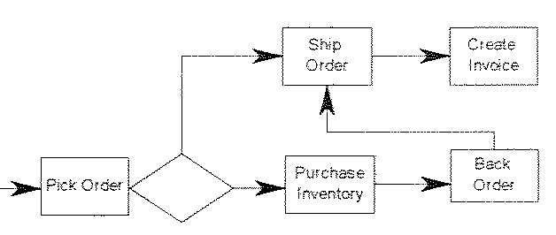
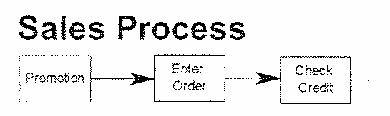
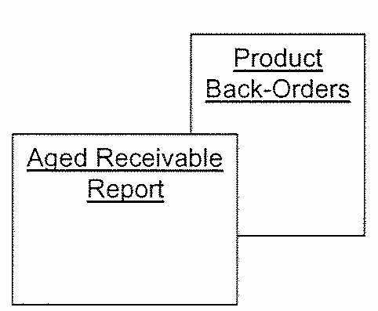
Common Mistakes in Entity Type Selection
Processes:
Reports:
A data model should not contain process-oriented requirements (e.g. order entry process, credit approval process , etc.).
A data model should be able to produces reports, but report itself does not need to be captured in the data model.
Notes:
While making the entity type selection it is common mistake to try to put processes and reports into a data model.
However it is important to understand that a data model only captures data requirements, not how those data requirements are maintained. Therefore, a data model should not contain process-oriented requirements (e.g. order entry process, credit approval process , etc.).
Reports are also developed from the data. For e.g. Product back order report, sales report, aged receivable report etc. These reports can be from single entity set or from combination of entity sets. The report should not be represented as any entity sets. Some reports which are developed completely as a view are shown in physical data model as views.

Slide 18
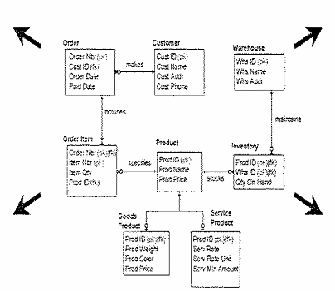
Business Metadata
Name
Sample Occurrences
Business Rules
Description
Meta-data is data about data that is used to defined and describe all modeling constructs (i.e. entity types, attributes, relationships).
It is extremely important to capture detailed meta-data throughout the entire modeling effort.
Notes:
Meta-data is data about data that is used to defined and describe all modeling constructs (i.e. entity types, attributes, relationships).
Each model construct has different types of meta-data.
The metadata has a lot of importance. Given the metadata, one can infer - the source of data, the operations done on data, the change log of data, the frequency of data, the data volume etc. These aspects are used in data storage design, the ETL design (in data warehousing) and report designs.
For e.g. if the data volume is too large then it can be stored in partitioned tables. The partitioned tables help in faster retrieval and faster addition of data.
The source of the data is the department that sends the data, hence if there is data discrepancy, that department can be contacted.
The metadata at data model level helps designers, developers and maintenance guys of both database team and application team. Since it is centralized, all can refer to it and any change required will be done at one place. One can quickly refer to the change through ‘comment’ in database (comment is provided in oracle database).

Slide 19
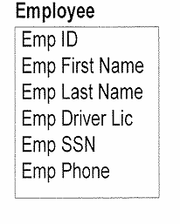
Attribute – Definition & Example
An attribute is a characteristic that describes an entity type and is typically expressed as a noun qualified by an adjective.
Attributes are listed inside the entity type to which they belong.
Notes:
An attribute is a characteristic that describes an entity type and is typically expressed as a noun qualified by an adjective.
They are shown inside the entity type box to which they belong.
An employee entity type is shown. The attributes are Employee ID, Employee First name, Employee last name, Employee driving license id,
Employee SSN id, Employee phone No.
There will be many more attributes of an employee in a real application.
The rules for an attribute are:
An attribute must:
-Be in its basic (atomic) form. For example:
Address can be stored in attributes such as: street, city, state, zip code
Phone number can be stored in attributes such as: Area code, prefix, number
-The attribute belongs or originates in only one entity type. For example employee ID originate in Employee entity type. But same attribute gets transferred to entity types where it is referred to as foreign key. For .e.g. The employee id will be present in Employee-Location Entity type. The dept ID of department entity type is present in Employee entity type.

Slide 20
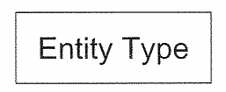
Metadata for Entity Type
Name
Description
Use concise, non-technical description (forms the basis for establishing group consensus and used for ongoing reference
Use examples for clarification
Volume and frequency of change
Specify expected data volume
Specify how often
Occurrences change, get added, deleted
Aliases
Specify “also known as” … very prevalent in large organizations. Example: Location, Unit etc.
Notes:
Metadata for entity helps in answering a few important questions such as What is the data source, what is its frequency, what is its usage etc.
An entity type, metadata would be : Name, description of the entity type, volume and frequency of change and aliases.
Many people who read the metadata information, or the people whom metadata details are sent on request are non technical people or those not familiar with data model terms. So The description should be concise and non technical.
The volume helps
-estimate the time it will take to populate the data
-decide kind of storage that is suitable
-If the data comes in a file what size it will have. Essentially it helps in capacity planning.
Frequency of change helps in defining table storage parameters like ‘The users that are allowed to update or delete the data’
The use of alias is also common. Sometimes alias defines the prevalent business name in the organization. For e.g. Vendor is also known as supplier.
Apart from it, the contact department etc also help in resolving data issues. One can contact the concerned department when problem arises.

Slide 21
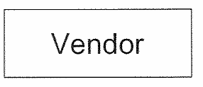
Entity Type Metadata Example
Name : Vendor
Description : A U.S. or domestic corporation that we have reviewed with respect to their qualifications for providing products to our company. Vendors are rated based on price, quality, delivery performance and financial stability.
Volume : 100
Frequency of Change : Monthly
Alias : Supplier
Notes:
An example of metadata for entity type Vendor is:
The entity type Name is Vendor.
Description is: A U.S. or domestic corporation that we have reviewed with respect to their qualifications for providing products to our company.
Vendor is rated based on price, quality, delivery performance and financial stability.
You can observe that this description provides information such as ‘it should be only domestic company’ and ‘what form the parameters for vendor rating’
There are 100 vendors for the company.
The vendor details are supplied each month.
Vendor is also known as supplier.

Slide 22
Attribute Metadata Example
Name : Employee ID
Description : In house assigned number used to identify all of our employees
Optionality : Mandatory
Data type : Integer
Length of data : 6
Domain : Range = 100000 to 999000
Rules : Must be unique
Alias : badge number, work number
Sample : 345203
Metadata for an attribute should include at least the name, description, Optionality, data type and length, domain, value rules, alias and sample occurrence
A data model may include more meta data than this but not less
All of the metadata helps to clearly define an attribute
Notes:
Let us see what metadata an Attribute has:
Attribute name is Employee ID. This may be also the primary key.
It is an in-house assigned number used to identify each employee.
It is mandatory for every record. So this will be not null.
Data type is Integer of length 6.
The Employee id can be assigned a number falling in the range 100000 - 999000
It Must be unique. Each record should have unique ID.
It can be also called badge number or work number.

Slide 23
Module Summary
Congratulations! You have now completed the 2nd part of the module “Data Modeling concepts”
You should now be able
What stages a data model goes through
What is Entity Type, Attribute
What is Metadata
Notes:
This course would have helped you understand,
- The conceptual data model, the logical data model and the physical data model.
- The properties of each, area it is used in and the benefits it provides.
- What is an entity type, an attribute and a relation and the importance of metadata.
With this , we come to the end of our 3-part series presentation on Data Modeling Concepts.
We hope that you were able to follow the explained concepts. I wish you good luck, as I leave you now with a small quiz for you to test your understanding.
Good luck and Thank you.

Slide 24
Quiz
Notes:
© 2009 Wipro Ltd – Internal & Restricted
‹#›

Slide 25
Question 1
1. Which is not a valid Data Model type:
Conceptual Model
Logical Model
Business Model
Physical Model
Notes:
© 2009 Wipro Ltd – Internal & Restricted
‹#›

Slide 26
Question 1
1. Which is not a valid Data Model type:
Conceptual Model
Logical Model
Business Model
Physical Model
Answer: C
Notes:
© 2009 Wipro Ltd – Internal & Restricted
‹#›

Slide 27
Question 2
2. Which statement is wrong about Logical Data Model
It is derived from conceptual model
It is database dependent
It is non-redundant single representation for all user views
It is picture that captures and communicates the information and business rules of the organization
Notes:
© 2009 Wipro Ltd – Internal & Restricted
‹#›

Slide 28
Question 2
2. Which statement is wrong about Logical Data Model
It is derived from conceptual model
It is database dependent
It is non-redundant single representation for all user views
It is picture that captures and communicates the information and business rules of the organization
Answer: B
Notes:
© 2009 Wipro Ltd – Internal & Restricted
‹#›

Slide 29
Question 3
3. Which is not a correct entity type
Customer
Employee
Order process
Department
Notes:
© 2009 Wipro Ltd – Internal & Restricted
‹#›

Slide 30
Question 3
3. Which is not a correct entity type
Customer
Employee
Order process
Department
Answer: C
Notes:
© 2009 Wipro Ltd – Internal & Restricted
‹#›

Slide 31
Question 4
4. Which is not the correct statement about an attribute
Attribute can be null
Attribute can have single value
Attribute can have multiple value
Attribute can defined without data type
Notes:
© 2009 Wipro Ltd – Internal & Restricted
‹#›

Slide 32
Question 4
4. Which is not the correct statement about an attribute
Attribute can be null
Attribute can have single value
Attribute can have multiple value
Attribute can defined without data type
Answer: D
Notes:
© 2009 Wipro Ltd – Internal & Restricted
‹#›

Slide 33
Question 5
5. Identify the incorrect statement from the following
Logical Model is derived from Conceptual Model
Physical Model is derived from Conceptual Model
Logical Model is database independent
Physical Model is derived from Logical Model
Notes:
© 2009 Wipro Ltd – Internal & Restricted
‹#›

Slide 34
Question 5
5. Identify the incorrect statement from the following
Logical Model is derived from Conceptual Model
Physical Model is derived from Conceptual Model
Logical Model is database independent
Physical Model is derived from Logical Model
Answer: B
Notes:
© 2009 Wipro Ltd – Internal & Restricted
‹#›

Slide 35
References
Publications
Courses
Course structure was conceptualized from Business Data Modeling training course offered by Inteq Group
Fundamentals of Database Systems by R Elmasri, S Navathe, Publisher - Addison Wesley
DWH Concepts
URL’s
Training Programs
www.learndatamodeling.com
www.agiledata.org
Wipro Data warehousing Training Material

Slide 36
Thank You
Anand Kumar
Project lead
Anand.akumar@wipro.com

